Slide 1
WELCOME DEAR STUDENTS
MODULE NAME: ANALYZE PROJECT REQUIREMENT

Slide 2
Project management approach
The agile working methodology or ‘movement’ allows project managers and other stakeholders to assess and examine the direction of the project during its life cycle.
Agile project management is an iterative approach to delivering a project throughout its life cycle.

Slide 3
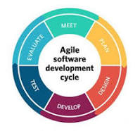
Life cycle of agile model

Slide 4
Waterfall
The waterfall model is a breakdown of project activities into linear sequential phases, meaning they are passed down onto each other, where each phase depends on the deliverables of the previous one and corresponds to a specialization of tasks..
A waterfall is a point in a river or stream where water flows over a vertical drop or a series of steep drops.

Slide 5
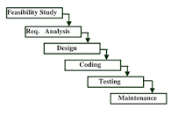
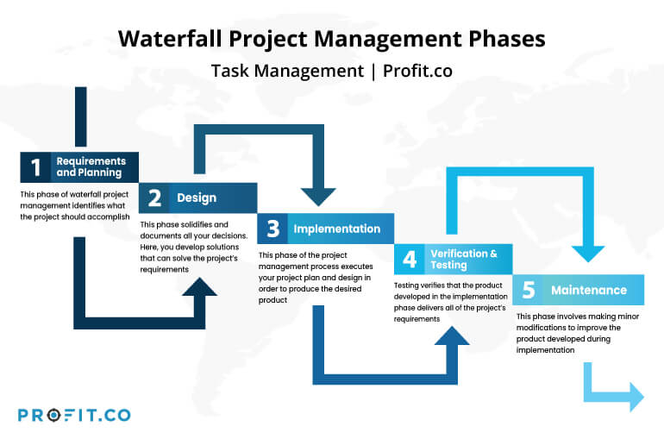
Life cycle of waterfall

Slide 6
✓ Project requirements
Project requirements are conditions or tasks that must be completed to ensure the success or completion of the project. They provide a clear picture of the work that needs to be done. They're meant to align the project's resources with the objectives of the organization.

Slide 7
Project requirements can be categorized into three main categories:
business,
solution,
stakeholder requirements.

Slide 8
Cont’
Business requirements are the high-level needs of the business. They address what's required and why the project is happening.
Solution requirements, which include both functional and non-functional requirements, are the specific features and characteristics of the product or service that meet all requirements, both business and stakeholder. Functional requirements describe something that a product or service is required to do.
A stakeholder is anyone who has an interest in the product or service that's being produced or provided. They may be internal stakeholders (employees) or external stakeholders (customers, regulators, or suppliers).

Slide 9
The main requirement on every project.
Performance requirement
Usability requirement
Recoverability requirement
Maintainability requirement
Accessibility requirement:

Slide 10
Cont’
Performance requirements define how well the software system accomplishes certain functions under specific conditions. Examples include the software's speed of response, throughput, execution time and storage capacity.
A usability requirement must state some required behavior that users want the system to perform. Usability is often measured in subjective ways (i.e., easy to use). Confer with the business users and identify the usability requirements that the distributed application must satisfy.

Slide 11
Cont’
Recovability requirement: Recoverability-Component Requirement: The ability to repair or replace system components, with minimum work effort, and with no loss or disruption of business functionality.
Maintainability defines the time required for a solution or its component to be fixed, changed to increase performance or other qualities, or adapted to a changing environment.
content and design clear and simple enough so that most people can use it without needing to adapt it, while supporting those who do need to adapt things.

Slide 12
Project scope
The project scope is the total amount of work that needs to be done to complete a project. It’s also one of the triple constraints of project management. Defining scope is part of the project planning process and helps project managers determine what the project goals, deliverables, tasks, costs and deadlines are.

Slide 13
Project Scope Statement
As mentioned above, the scope statement is the project management document that describes the scope of a project.

Slide 14
The elements included in project scope statement.
Project Goals & Objectives: The project requirements or acceptance criteria.
Project Deliverables: The outcomes of project tasks.
Project Exclusions & Constraints: As a project manager you need to explain what can’t be done and why.
Project Assumptions: Some initial assumptions that the project management team has before executing the work.
Project Milestones: These mark important moments in your project life cycle, such as the end of a phase.
Scope Baseline: Your original scope as you planned it. The scope baseline allows you to compare actual results against what it’s in your scope statement.

Slide 15
Research methodology and tools are correctly determined in accordance with project goals.
Research methodology
Research methodology is the specific procedures or techniques used to identify, select, process, and analyze information about a topic.

Slide 16
Types of research methodology
Fundamental research:“ means basic and applied research in science and engineering, is “experimental or theoretical works mainly performed to obtain new knowledge on the basics of observable phenomena or facts.
Exploratory research: is a methodology approach that investigates research questions that have not previously been studied in depth(byimbitse).
Survey research:

Slide 17
Cont’
Survey research is defined as "the collection of information from a sample of individuals through their responses to questions".
Case studies: A case study is a research approach that is used to generate an in-depth, multi-faceted understanding of a complex issue in its real-life context.

